Slide 1


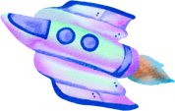

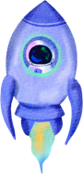

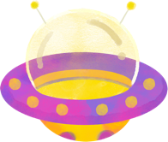


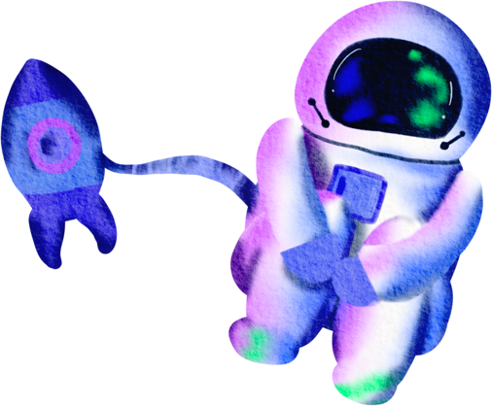


BEYOND
UFO
Flatiron School
Jayla, Jeesoo, Ricky

Slide 2


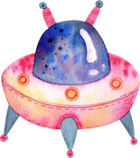







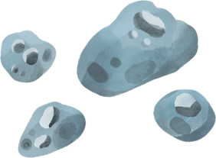
Meet Our Team
Jayla Haskins
Jeesoo Jhun
Rickey Bocek

Slide 3

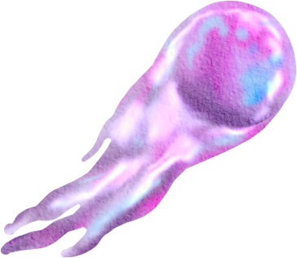
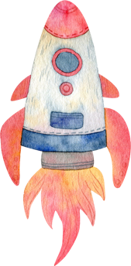

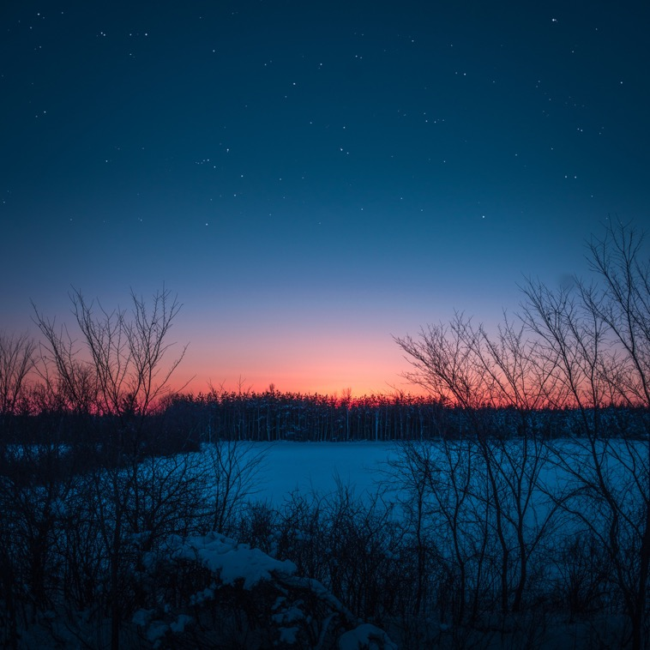
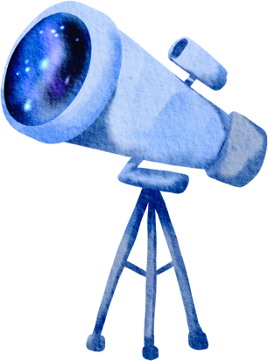

Contents
Overview
Data Understanding
Methods
Analysis & Results
- Regions, Timing, Shapes, Description
Insights & Recommendations
Conclusions

Slide 4
Overview
Objective:
Identify UFO sighting patterns for Tourism, Government, and Research
2. Key Questions:
Where and when are sightings most frequent?
What shapes and descriptions are common?
Are there patterns by time or season?
3. Method: Descriptive Analysis, Correlations, Visualizations
4. Outcome: Insights for tourism and strategic planning

Slide 5

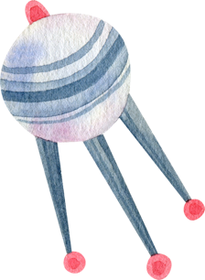
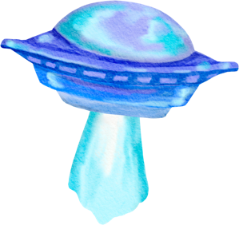


Data
Understanding
Dataset includes UFO sighting reports with details on Date, Time, Location, Shape, and Duration
2. Key questions addressed
Regional frequency, Sighting patterns, and Correlations
between Timing and Sightings
Notes:
Show overall dataset briefly (Result of .describe or .info)

Slide 6

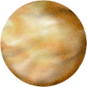
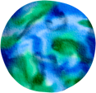

Methods
1
Descriptive
- Descriptive analysis of sighting frequencies by Region, Time, and Shape
2
Correlation
- Correlation analysis to explore relationships between Encounter duration and Time of Day
3
Visualization
- Heatmaps, Bar charts, and Distribution plots

Slide 7



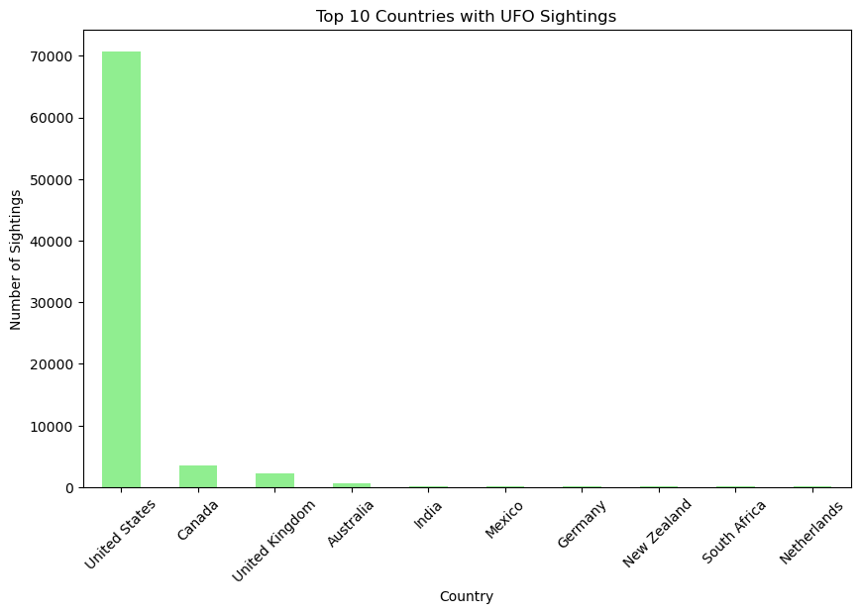
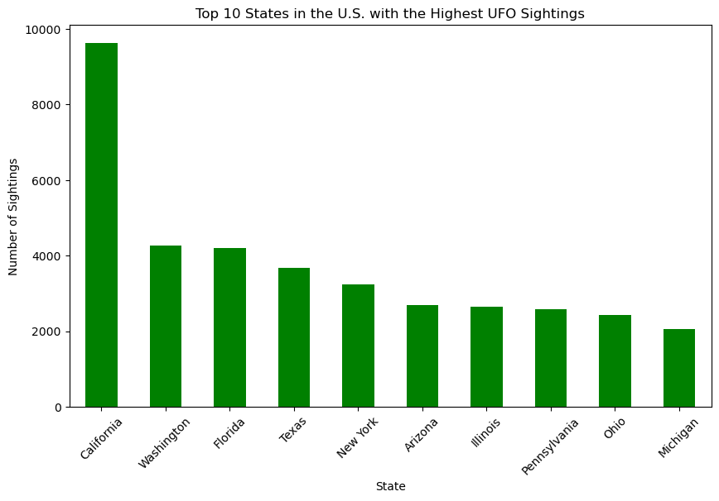
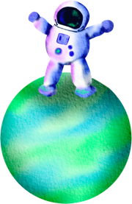

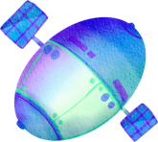
Regions
United States (California, Washington)
Elaborate on what you want to discuss.
Elaborate on what you want to discuss.
Elaborate on what you want to discuss.
Elaborate on what you want to discuss.
Notes:
Insight: Certain regions, particularly states like California and Texas, have the highest density of UFO sightings in the U.S.
Business Impact: These areas can be targeted for promoting UFO-themed tourism activities, such as skywatching tours and events.

Slide 8
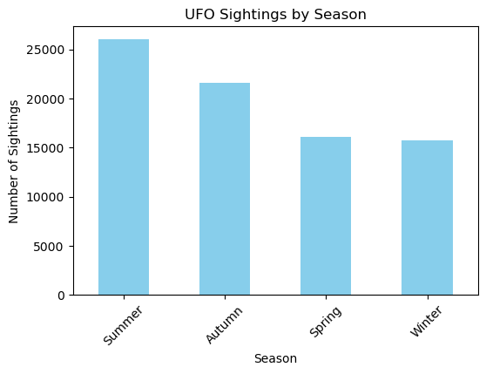
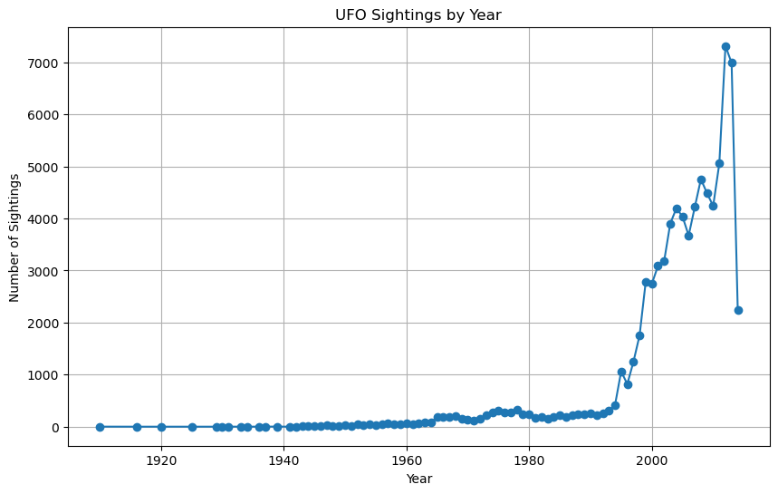
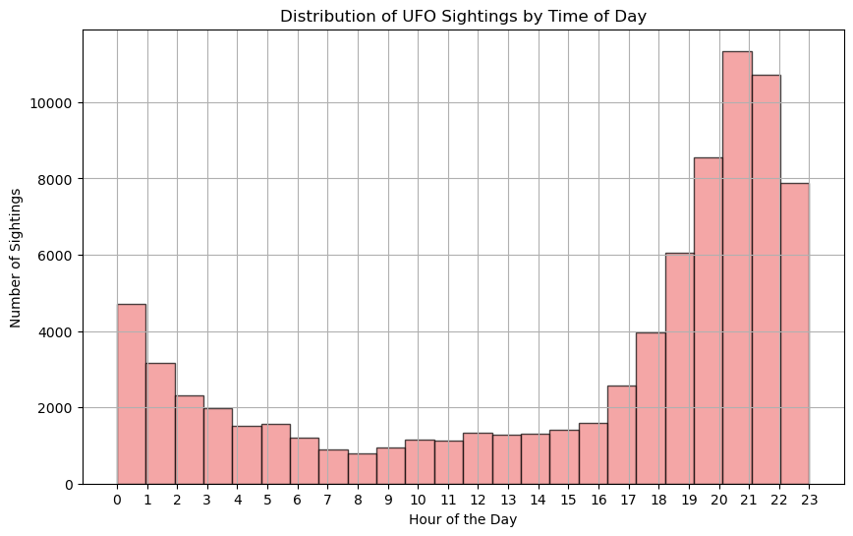
Timing
Elaborate on what you want to discuss.
Elaborate on what you want to discuss.
Elaborate on what you want to discuss.
Elaborate on what you want to discuss.
Elaborate on what you want to discuss.
Notes:
Insight: UFO sightings peak during late evening hours (8 p.m. - midnight) and are most frequent in autumn and summer.
Business Impact: Align tourism experiences with these peak times and seasons to increase the chances of tourists witnessing sightings, enhancing the appeal of tours.

Slide 9
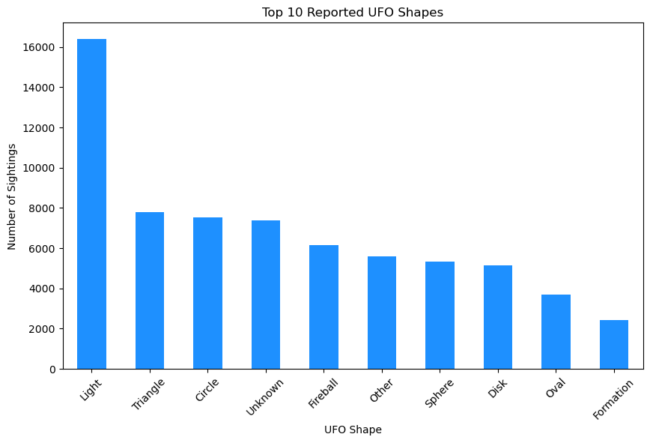
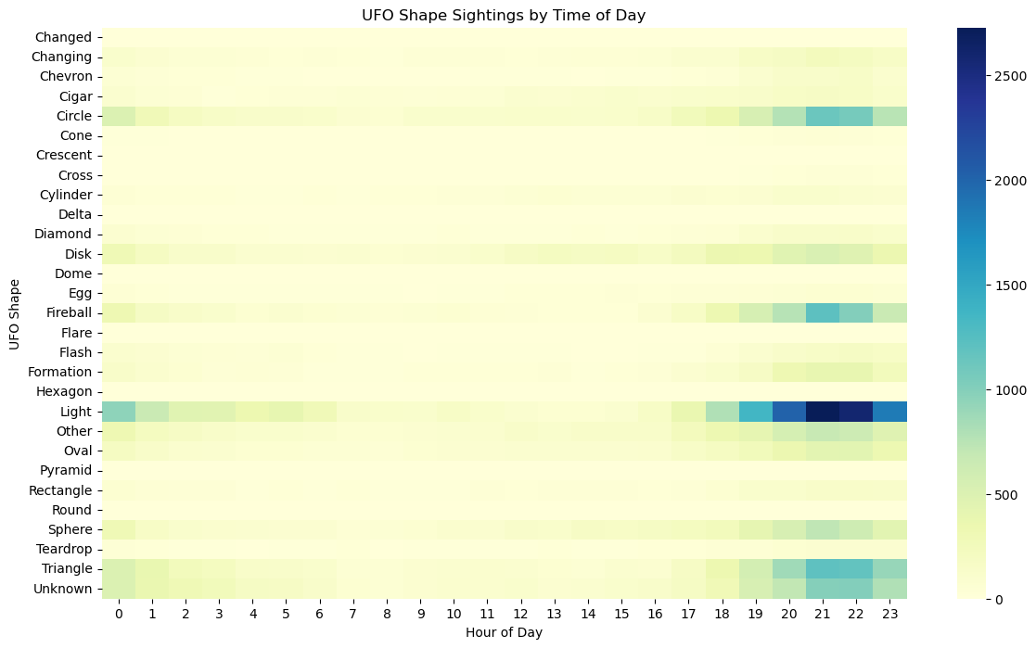
Shapes
Elaborate on what you want to discuss.
Elaborate on what you want to discuss.
Elaborate on what you want to discuss.
Elaborate on what you want to discuss.
Elaborate on what you want to discuss.

Slide 10
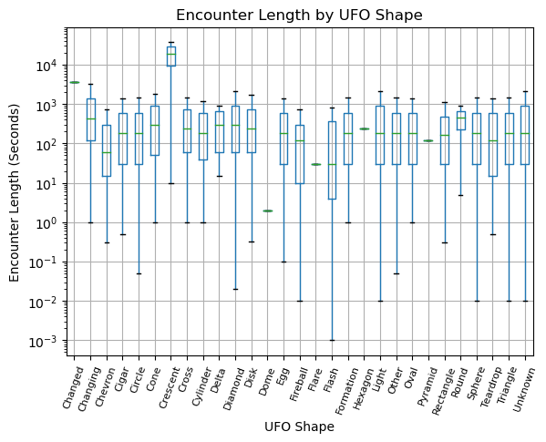
Shapes
Elaborate on what you want to discuss.
Elaborate on what you want to discuss.
Elaborate on what you want to discuss.
Elaborate on what you want to discuss.
Elaborate on what you want to discuss.

Slide 11
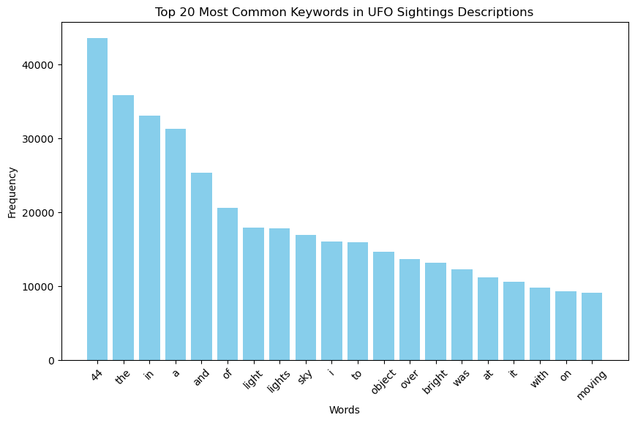
Description
Elaborate on what you want to discuss.
Elaborate on what you want to discuss.
Elaborate on what you want to discuss.
Elaborate on what you want to discuss.
Elaborate on what you want to discuss.

Slide 12


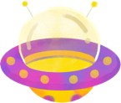




Insights
Identifying Key Regions for Tourism
Timing Opportunities for Tour Experiences
Themed Experiences Based on UFO Shapes and Description
* Link to Tableu :
Notes:
1. Identifying Key Regions for Tourism
Insight: Certain regions, particularly states like California and Washington, have the highest density of UFO sightings in the U.S.
Business Impact: These areas can be targeted for promoting UFO-themed tourism activities, such as skywatching tours and events.
2. Timing Opportunities for Tour Experiences
Insight: UFO sightings peak during late evening hours (8 p.m. - midnight) and are most frequent in autumn and summer.
Business Impact: Align tourism experiences with these peak times and seasons to increase the chances of tourists witnessing sightings, enhancing the appeal of tours.
3. Themed Experiences Based on UFO Shapes and Description
Insight: Commonly reported shapes like "light," "circle," and "triangle" in UFO Shape are associated with different types and durations of sightings.
Business Impact: Develop themed attractions and storytelling based on these shapes, creating unique experiences tailored to visitor preferences, such as “quick flash sightings” or “extended triangle encounters. Also, Utilize the common words found in UFO descriptions, like "bright," ”moving," or ”lights”, “Sky” to craft storytelling tours that connect with tourists emotionally. Offer experiences that play up the excitement, awe, or mystery often found in the descriptions to create diverse tourist packages, such as "Mystery Night Adventures" or "Sky Light Spectacles."

Slide 13


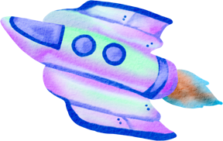
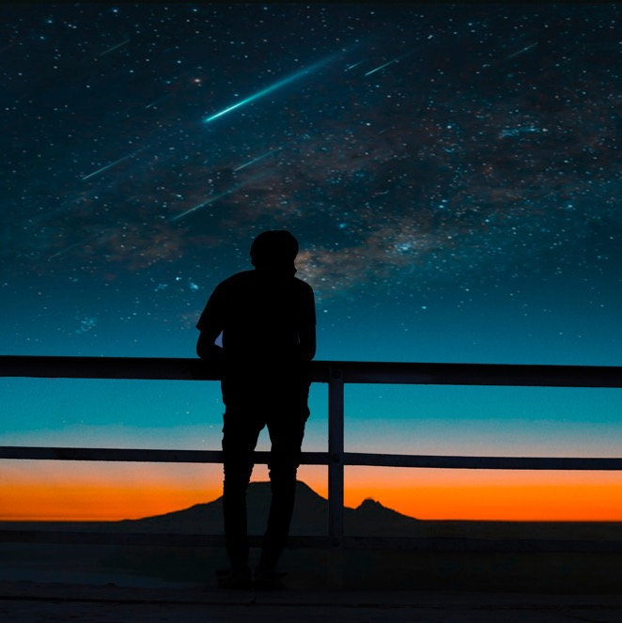
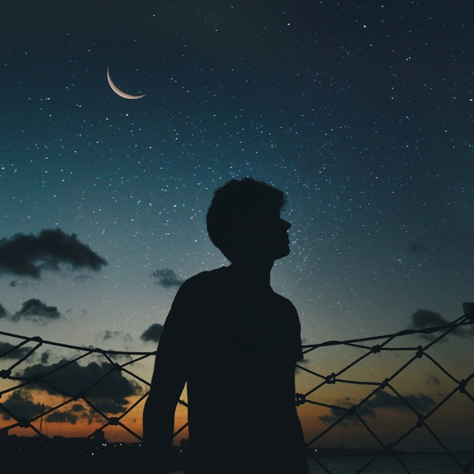
Conclusion
Our findings show how we can capitalize on both the Regions and Timing of UFO sightings to create unforgettable experiences.
By focusing on the key areas, the right times of the year, and creating themed activities around what people are most likely to see, we can boost tourism and give visitors a truly out-of-this-world adventure.

Slide 14
